Slide 1

ANDROID CHAT APPLICATION
vCHAT
Member:
Mukesh Verma
Akshay Mistry

Slide 2
Chat Application
Android Chat Application is robust, Integrated technology.
It deals with the maintenance of Chats of the respective Users in the Social Media Sector.
It deals with processing of different chat made through Applications.

Slide 3
Need Of Project
It provide the user friendly environment where user can get better chat Service.
It keeps a track of users added in the database. It also make functioning of Chat faster.

Slide 4
Data flow diagram
Login
Chat Dashboard
Chat
Sign Out

Slide 5
Content of Applications
1)Index:
The Dashboard of Chat of the system.
2)Login:
Here the user will do the required login to enter the chat and enter the Chat Dashboard.
3)Notifications:
Will see the Notifications added to the respective Chat.
4)Sign Out:
This module help to Sign Out of the module.

Slide 6
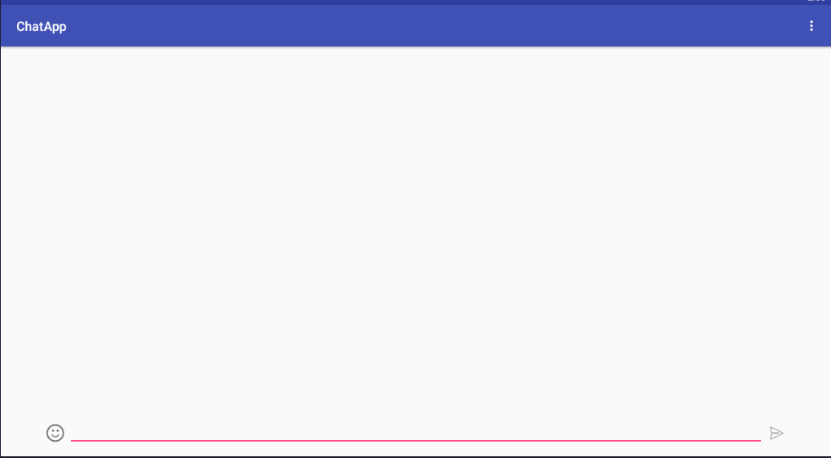
App Chat Page

Slide 7
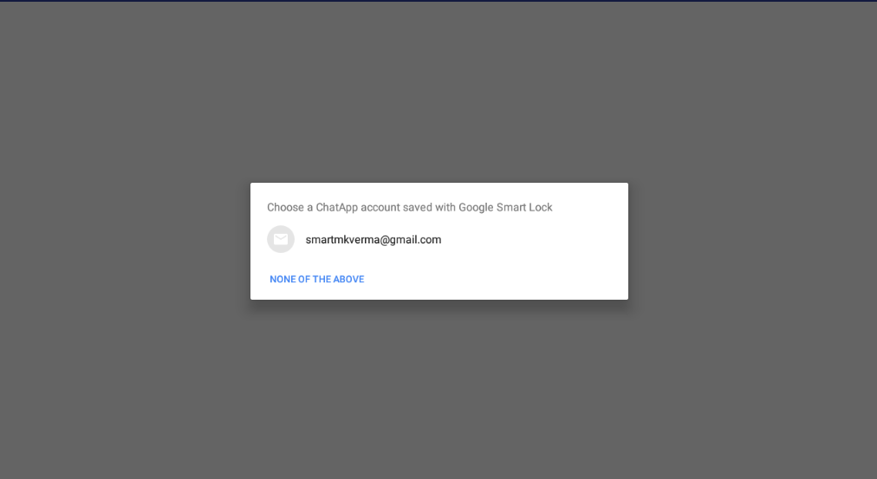
Login Module:

Slide 8
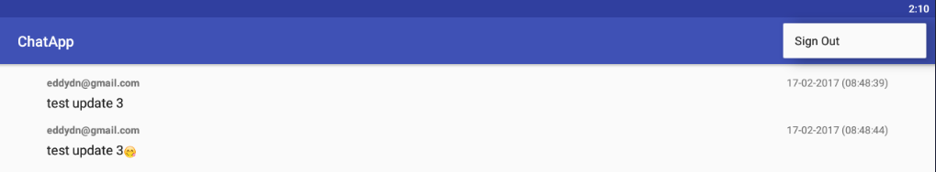
Sign Out Menu:

Slide 9
Future Enhancements:
Will add the latest feature available for the user to have a better chat Experience.
Include the Privacy and Setting for User Profile managements.
Update the Module App with the New Release of the Version Of vCHAT.
Include the Flash Screen in the Applications Module.

Slide 10
THANK YOU

